Slide 1

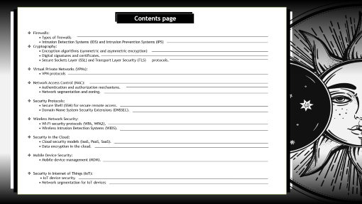


Slide 2





Slide 3



Slide 5





Slide 6

Rajibul Molla
Department Name : ~ MCA
paper-code : ~

Slide 7




Slide 8

Contents page
Contents page
Firewalls:
• Types of firewalls
• Intrusion Detection Systems (IDS) and Intrusion Prevention Systems (IPS)
Cryptography:
• Encryption algorithms (symmetric and asymmetric encryption)
• Digital signatures and certificates.
• Secure Sockets Layer (SSL) and Transport Layer Security (TLS) protocols.
Virtual Private Networks (VPNs):
• VPN protocols
Network Access Control (NAC):
• Authentication and authorization mechanisms.
• Network segmentation and zoning.
Security Protocols:
• Secure Shell (SSH) for secure remote access.
• Domain Name System Security Extensions (DNSSEC).
Wireless Network Security:
• Wi-Fi security protocols (WPA, WPA2).
• Wireless Intrusion Detection Systems (WIDS).
Security in the Cloud:
• Cloud security models (IaaS, PaaS, SaaS).
• Data encryption in the cloud.
Mobile Device Security:
• Mobile device management (MDM).
Security in Internet of Things (IoT):
• IoT device security.
• Network segmentation for IoT devices

Slide 9
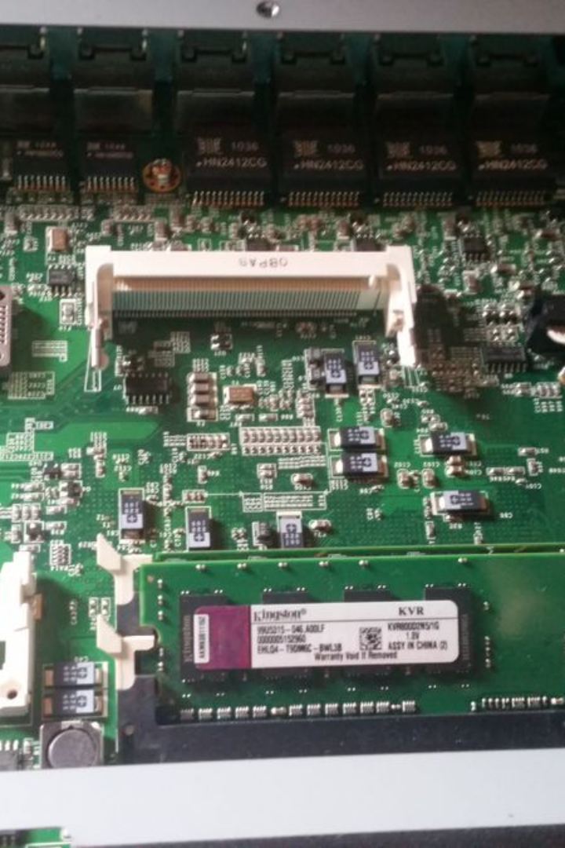
Exploring Network Security: Firewalls
Firewalls play a crucial role in network security by protecting against unauthorized access. In this presentation, we'll explore different types of firewalls and discuss intrusion detection and prevention systems.
Learn about different types of firewalls and why they are essential to the security of your network. Dive deep into Intrusion Detection Systems (IDS) and Intrusion Prevention Systems (IPS) and find out how they can help protect against threats.

Slide 10


Proxy firewalls act as intermediaries between internal devices and the outside world, protecting systems by receiving and forwarding network traffic.
~ Proxy Firewalls
Stateful inspection firewalls monitor the state of network connections and make access decisions based on the context of the traffic.
~ Stateful Inspection Firewalls
Packet filtering firewalls examine incoming and outgoing data packets to determine whether to allow or block them based on predetermined criteria.
~ Packet Filtering Firewalls
Types of Firewalls

Slide 11
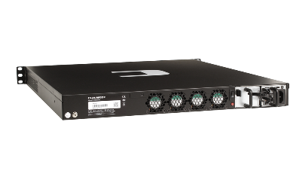
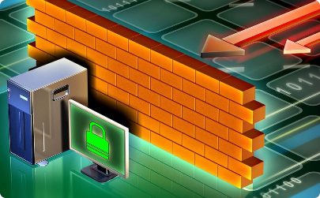
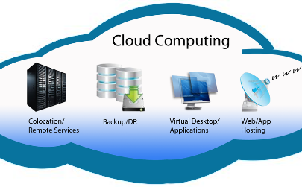
Firewall Deployment Strategies
Hardware Firewalls
Software Firewalls
Cloud-Based Firewalls
Learn about the different types of software firewalls and how they can be used to secure your network.
Discover the advantages of cloud-based firewalls and how they can provide scalable and flexible security solutions.
Understand the benefits of hardware firewalls and how they can protect your network.

Slide 12

Intrusion Detection Systems (IDS)
Network IDS
Host IDS
Passive IDS
Network IDS monitors network traffic in real-time, detecting and alerting on suspicious activities and potential security breaches.
Host IDS focuses on individual devices, identifying abnormal behavior and unauthorized access attempts at the host level.
Passive IDS doesn't interfere with network traffic and works by analyzing copies of network packets obtained from network taps or network mirroring.

Slide 13

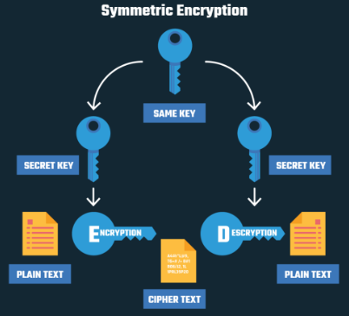
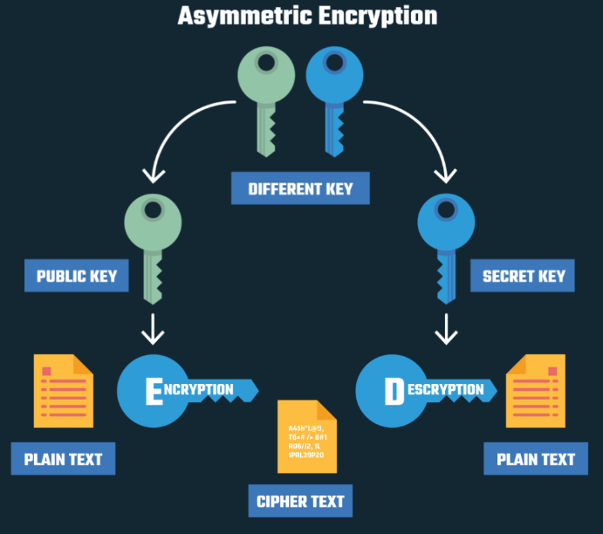
Cryptography
Encryption algorithm does is create a new language, and hide sensitive data by transforming it into this secret code, which you can only decrypt and turn back to plaintext if you know the rules, or what's called a key. The key represents the mathematical steps the algorithm took to convert your text from "Hello World" into "XJtg920kl#aJFJ"%*¨*FK". Without it, you can't decrypt the data, and thus it is protected from unauthorized access.
Asymmetric encryption, on the other hand, was created to solve the inherent issue of symmetric encryption: the need of sharing a single encryption key that is used both for encrypting and decrypting data.
In this type of encryption, there is only one key, and all parties involved use the same key to encrypt and decrypt information. By using a single key, the process is straightforward, as per the following example: you encrypt an email with a unique key, send that email to your friend Tom, and he will use the same symmetric key to unlock/decrypt the email .
~ Encryption Algorithms
~Asymmetric Encryption
~ Symmetric Encryption

Slide 14
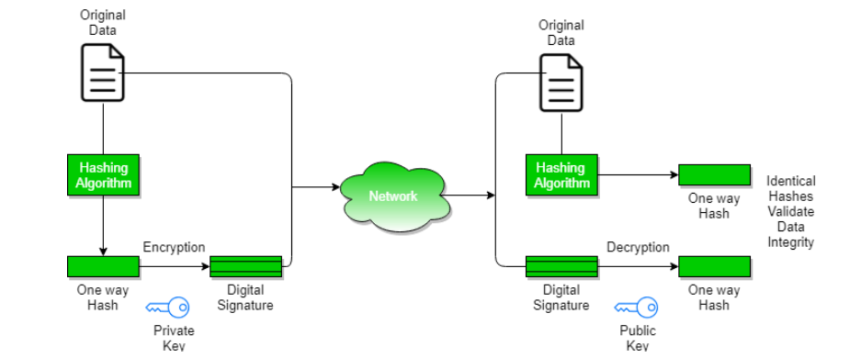
Digital Signatures & Certificates
A digital signature is a mathematical technique used to validate the authenticity and integrity of a message, software, or digital document

Slide 15
Benefits of Digital Signatures :
Legal documents and contracts: Digital signatures are legally binding. This makes them ideal for any legal document that requires a signature authenticated by one or more parties and guarantees that the record has not been altered.
Sales contracts: Digital signing of contracts and sales contracts authenticates the identity of the seller and the buyer, and both parties can be sure that the signatures are legally binding and that the terms of the agreement have not been changed.
Financial Documents: Finance departments digitally sign invoices so customers can trust that the payment request is from the right seller, not from a bad actor trying to trick the buyer into sending payments to a fraudulent account.
Health Data: In the healthcare industry, privacy is paramount for both patient records and research data. Digital signatures ensure that this confidential information was not modified when it was transmitted between the consenting parties.
Federal, state, and local government agencies have stricter policies and regulations than many private sector companies. From approving permits to stamping them on a timesheet, digital signatures can optimize productivity by ensuring the right person is involved with the proper approvals.
Shipping Documents: Helps manufacturers avoid costly shipping errors by ensuring cargo manifests or bills of lading are always correct. However, physical papers are cumbersome, not always easily accessible during transport, and can be lost. By digitally signing shipping documents, the sender and recipient can quickly access a file, check that the signature is up to date, and ensure that no tampering has occurred
Drawbacks of Digital Signatures :
Dependence on Key Management: Digital signatures rely on the secure management of cryptographic keys. This means that the sender must keep their private key safe and secure from unauthorized access, while the recipient must verify the sender’s public key to ensure its authenticity. Any failure in key management can compromise the security of the digital signature.
Complexity: Digital signatures require a complex process of key generation, signing, and verification. This can make them difficult to implement and use for non-technical users.
Compatibility: Different digital signature algorithms and formats may not be compatible with each other, making it difficult to exchange signed messages across different systems and applications.
Legal Recognition: Although digital signatures have legal recognition in many countries, their legal status may not be clear in all jurisdictions. This can limit their usefulness in legal or regulatory contexts.
Revocation: In case of key compromise or other security issues, digital signatures must be revoked to prevent their misuse. However, the revocation process can be complex and may not be effective in all cases.
Cost: Digital signatures may involve additional costs for key management, certificate issuance, and other related services, which can make them expensive for some users or organizations.
Limited Scope: Digital signatures provide authentication and integrity protection for a message, but they do not provide confidentiality or protection against other types of attacks, such as denial-of-service attacks or malware.

Slide 16
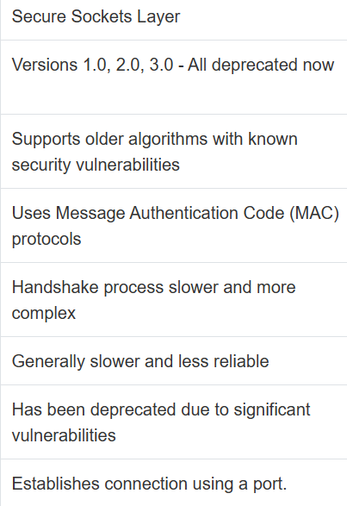
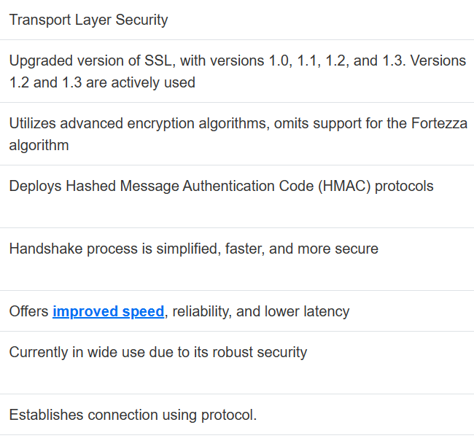
SSL (Secure Sockets Layer) :
is foundational in developing secure online communications. It helps secure data transfers between a web server and a browser. Its primary function is to encrypt data, turning it into complex codes difficult for unauthorized parties to decipher.SSL establishes an encrypted link between a web server and a client typically, a web server, a browser, a mail server, and a mail client. It secures all data between the web server and the browser, making it private and integral. SSL involves two main processes: the handshake between the client and server to establish a secure connection, followed by the bulk data transfer. During the handshake phase, the server and client agree on various parameters to establish the connection. It includes the decision to use SSL (and what version of the protocol), the decision to use a cipher suite, and the validation of the server's digital certificate, among other parameters.
TLS (Transport Layer Security) :
SSL (Secure Sockets Layer)
TLS (Transport Layer Security)
is an updated, more secure version of SSL. While the technical aspects of SSL and TLS are significantly different, their overall goals are similar. The primary focus is to provide privacy and data integrity between two communicating applications. TLS uses stronger hash algorithms and can function on different ports. It also allows "forward secrecy" - if a session's key is compromised, past session keys won't be compromised. TLS carries out a handshake process like SSL, with more built-in protection against attacks. Just like SSL, it then transfers the bulk data based on the agreed terms of the handshake.
While they both serve similar functions, TLS is the newer, more secure protocol. Major browsers have discontinued support for SSL 3.0 due to vulnerabilities.
improved speed

Slide 17
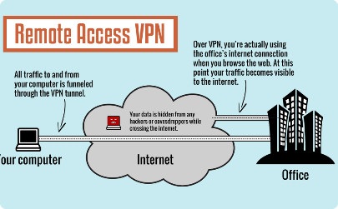
Virtual Private Networks (VPNs)
VPN Protocols
A VPN Protocol is a set of rules that govern how data is transmitted between your device and a virtual private network (VPN) server. VPN apps use these protocols to establish a secure and stable connection.
Types of Virtual Private Network (VPN) Protocols :
Internet Protocol Security (IPSec)
Layer 2 Tunneling Protocol (L2TP)
Point–to–Point Tunneling Protocol (PPTP)
SSL and TLS
Secure Shell (SSH)
SSTP (Secure Socket Tunneling Protocol)
IKEv2 (Internet Key Exchange version 2)
WireGuard
OpenVPN
VPN protocols are important because they define the rules for how data is transmitted between your device and a virtual private network (VPN) server. These protocols ensure that your online activities are securely and privately transmitted, protecting your data from potential cyber threats, hackers, and other prying eyes. VPN protocols are the foundation of a secure and stable VPN connection

Slide 18
Network Access Control (NAC)
1
Authentication & Authorization Mechanisms
As mentioned, authentication and authorization may sound alike, but each plays a different role in securing systems and data. Unfortunately, people often use both terms interchangeably as they both refer to system access. However, they are distinct processes. Simply put, one verifies the identity of a user or service before granting them access, while the other determines what they can do once they have access.
The best way to illustrate the differences between the two terms is with a simple example. Let's say you decide to go and visit a friend's home. On arrival, you knock on the door, and your friend opens it. She recognizes you (authentication) and greets you. As your friend has authenticated you, she is now comfortable letting you into her home. However, based on your relationship, there are certain things you can do and others you cannot (authorization). For example, you may enter the kitchen area, but you cannot go into her private office. In other words, you have the authorization to enter the kitchen, but access to her private office is prohibited
2
Network Segmentation & Zoning
network security practices that can help limit the scope of attacks, prevent malware from spreading, and disrupt lateral movements across an IT ecosystem .

Slide 19
Security Protocols
Secure Shell (SSH) is a cryptographic network protocol used for securely operating network services over an unsecured network. It primarily provides encrypted remote login and command execution capabilities, allowing users to access and manage remote systems and servers.SSH uses a client-server architecture and public-key cryptography for authentication, ensuring that the connection between the client and server is secure and protected from eavesdropping and tampering.SSH was developed as a more secure alternative to plaintext protocols like Telnet, Rlogin, and Rsh, which have significant security vulnerabilities. It is widely implemented through the OpenSSH software package, an open-source implementation of the SSH protocol.
Remote command execution
Users can execute single commands on remote systems securely without the need for a full interactive shell session
Domain Name System Security Extensions (DNSSEC) :
The Domain Name System Security Extensions (DNSSEC) is a feature of the Domain Name System (DNS) that authenticates responses to domain name lookups. It does not provide privacy protections for those lookups, but prevents attackers from manipulating or poisoning the responses to DNS requests.

Slide 20
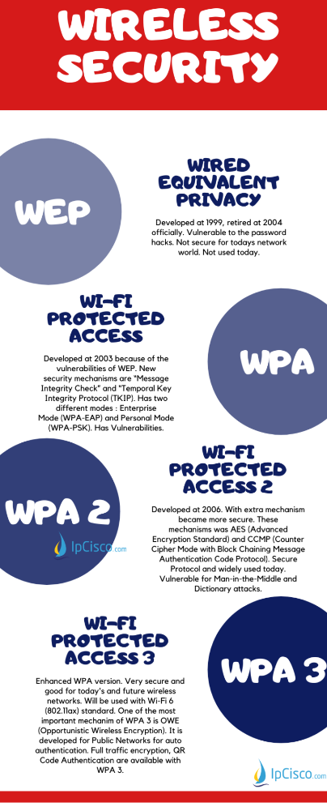
Wireless Security Protocols
In Wireless LANs , Access Point Passwords are important. But passwords are only the half of the security. Password Encryption is the second half. So, according to used Password Encryption, your system is vulnerable, secured or more secured. To achieve various security levels, different password encryptions are used. So what are these Wireless Security Protocols? These Wireless Security Protocols are WEP, WPA, WPA2 and WPA3.
WPA/WPA2
000
Wi-Fi Protected Access (WPA) was developed at 2003 by Wi-Fi Alliance. Because of the vulnerabilities of WEP, a new protocol must be developed. It is done with Wi-Fi Protected Access (WPA). WPA was using 256-bit WPA-PSK (Pre-Shared Key).
With WPA, some additional security mechanisms has developed. Two of these new security mechanisms are “Message Integrity Check” and “Temporal Key Integrity Protocol (TKIP)”. With Message Integrity Check mechanism, the message content became more secure towards hackers. With TKIP, key system had changed top Per-Packet. After a while instead of TKIP, AES (Advanced Encryption Standard) would be used.
WPA
(Wi-Fi Protected Access 1)
WPA2 (Wi-Fi Protected Access 2) has developed at 2006. It was advanced version of first WPA. Vulnerable parts of WPA become stronger with WPA2.
WPA2 offered new encryption and authentication mechanisms to provide more secured networks. These mechanisms was AES (Advanced Encryption Standard) and CCMP (Counter Cipher Mode with Block Chaining Message Authentication Code Protocol). These mechanisms was being used instead of previous mechanism TKIP. For interoparability, TKIP was also used but as a fallback.
WPA2
(Wi-Fi Protected Access 2)

Slide 21
A Wireless Intrusion Detection System (WIDS) is a commercial technology that monitors the radio frequency spectrum for unauthorized wireless transmissions and activities. It uses a system of sensors to monitor the network for unauthorized devices, such as rogue access points. WIDS can help detect and prevent various types of wireless attacks, such as denial of service, man-in-the-middle, rogue access point, evil twin, and spoofing

Slide 22
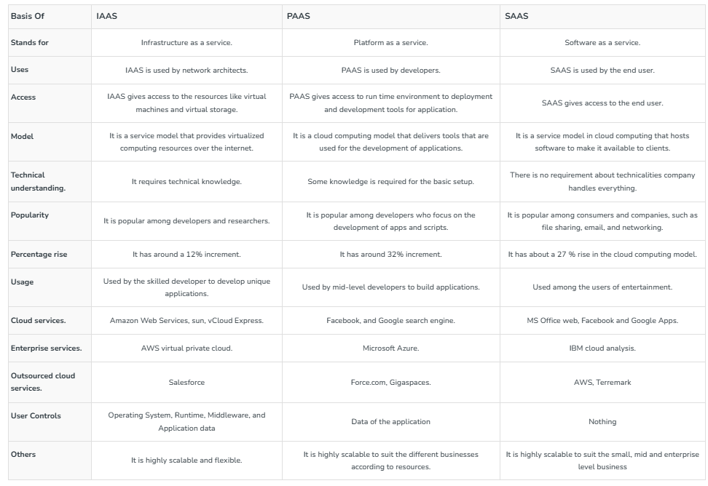
~ IAAS
Infrastructure As A Service (IAAS)
Infrastructure As A Service (IAAS) is means of delivering computing infrastructure as on-demand services. It is one of the three fundamental cloud service models. The user purchases servers, software data center space, or network equipment and rent those resources through a fully outsourced, on-demand service model. It allows dynamic scaling and the resources are distributed as a service. It generally includes multiple-user on a single piece of hardware.
It totally depends upon the customer to choose its resources wisely and as per need. Also, it provides billing management too.
~ PAAS
Platform As A Service (PAAS)
Platform As A Service (PAAS) is a cloud delivery model for applications composed of services managed by a third party. It provides elastic scaling of your application which allows developers to build applications and services over the internet and the deployment models include public, private and hybrid.
Basically, it is a service where a third-party provider provides both software and hardware tools to the cloud computing. The tools which are provided are used by developers. PAAS is also known as Application PAAS. It helps us to organize and maintain useful applications and services. It has a well-equipped management system and is less expensive compared to IAAS.
~ SAAS
Software As A Service (SAAS)
Software As A Service (SAAS) allows users to run existing online applications and it is a model software that is deployed as a hosting service and is accessed over Output Rephrased/Re-written Text the internet or software delivery model during which software and its associated data are hosted centrally and accessed using their client, usually an online browser over the web. SAAS services are used for the development and deployment of modern applications.
It allows software and its functions to be accessed from anywhere with good internet connection device and a browser. An application is hosted centrally and also provides access to multiple users across various locations via the internet.

Slide 23
Mobile Device Security
Mobile device management (MDM
With a mature MDM platform, IT and Security departments can manage all of a company’s devices, no matter their type or operating system. An effective MDM platform helps keep all devices secure while keeping the workforce flexible and productive.

Slide 24



Security in Internet of Things (IoT)
IoT Device Security
Network Segmentation
Security for the Internet of Things means protecting internet devices and the networks they connect to from online threats and breaches. This is achieved by identifying, monitoring, and addressing potential security vulnerabilities across devices. At its simplest, IoT security is the practice that keeps IoT systems safe
Network segmentation is an architectural approach that divides a network into multiple segments or subnets, each acting as its own small network. This allows network administrators to control the flow of network traffic between subnets based on granular policies. Organizations use segmentation to improve monitoring, boost performance, localize technical issues and – most importantly – enhance security.
.

